Slide 1

Supermarket sales prediction
Vivek Purohit

Slide 2
Hi, I am Vivek Purohit, and I'm excited to share my project on supermarket sales prediction with you. In today's dynamic retail landscape, supermarkets and grocery stores play a pivotal role in our daily lives. They serve as essential hubs where customers purchase a wide range of products, from fresh produce to household essentials. However, for supermarket owners and managers, understanding and predicting sales trends is essential for effective inventory management, staff scheduling, and overall business success.
Vivek Purohit

Slide 3
Project Objectives
Data Collection: | Data Preprocessing: | Model Training and Evaluation: | Model Training and Evaluation:
Gathering comprehensive and accurate historical sales data is the first step. | Cleaning and transforming the data to ensure it's suitable for modeling | Training the selected model on historical data and evaluating its performance using appropriate metrics | To visualize the results of supermarket sales prediction model, in various types of plots and charts.
This data includes information on product categories, pricing, promotions, and sales quantities. | This includes handling missing values, encoding categorical variables, and dealing with outliers. | Such as Mean Absolute Error (MAE) or Root Mean Square Error (RMSE).

Slide 4
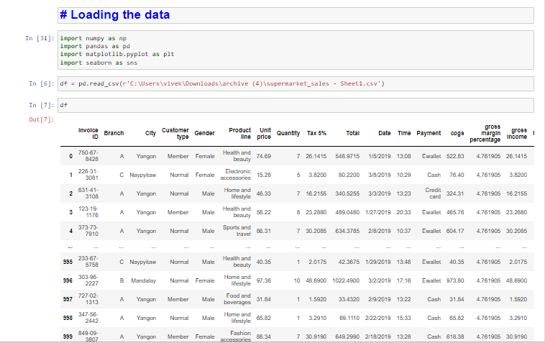
Loading the data
Here the data is loaded from the csv format into the df variable using read.csv method

Slide 5
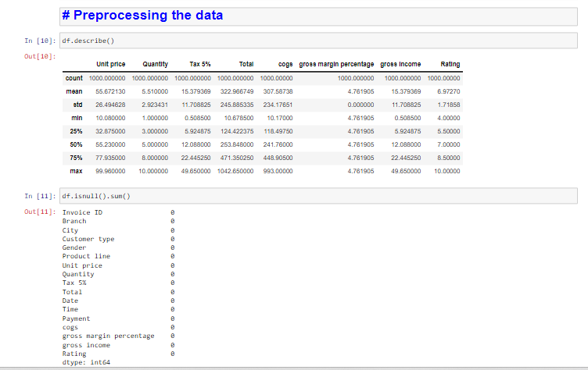
Pre-processing the data
Cleaning and transforming the data to ensure it's suitable for modeling. This includes handling missing values, encoding categorical variables, and dealing with outliers.

Slide 6
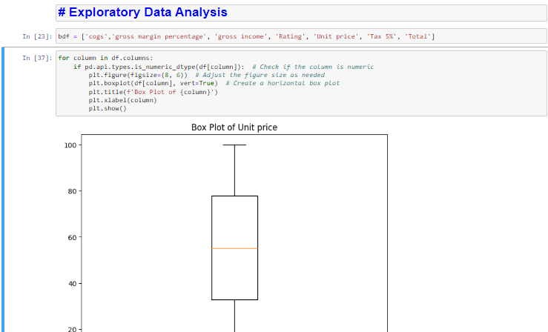
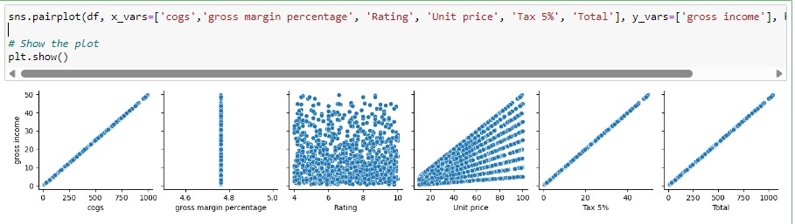
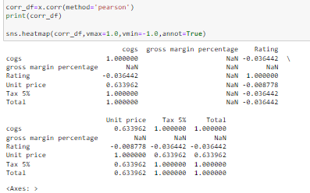
Exploratory Data Analysis
Exploratory Data Analysis (EDA) is a crucial step in data analysis that involves examining and understanding your data before diving into modeling or making decisions.

Slide 7
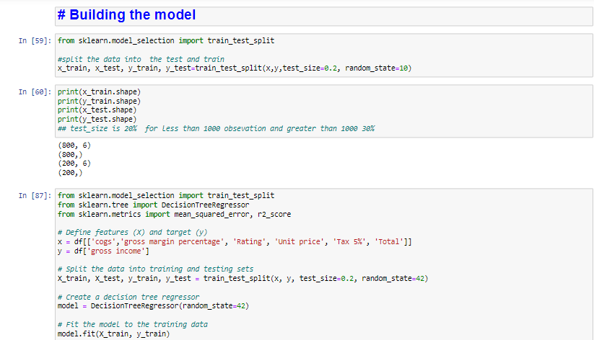
Model Training
Training the selected model on historical data and evaluating its performance using appropriate metrics such as Mean Absolute Error (MAE) or Root Mean Square Error (RMSE).

Slide 8
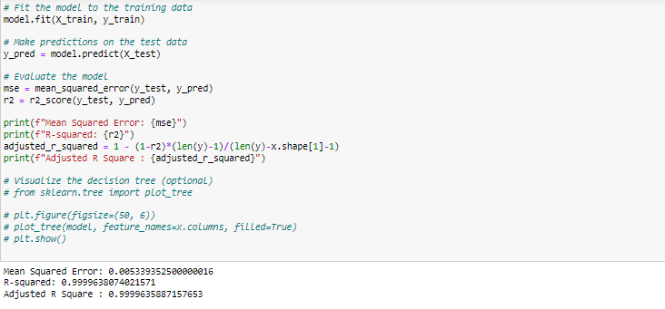
Evaluation:
Training the selected model on historical data and evaluating its performance using appropriate metrics such as Mean Absolute Error (MAE) or Root Mean Square Error (RMSE).

Slide 9
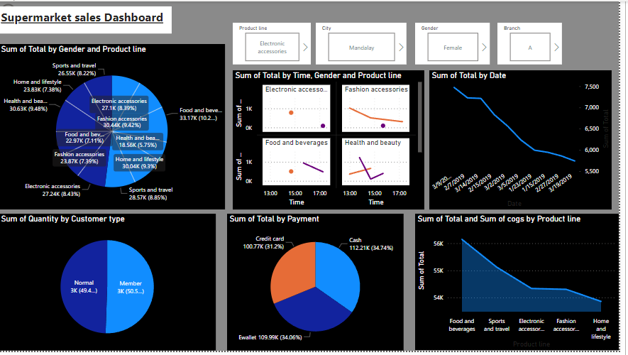
Visualisation:
a dynamic and interactive visualization, using tools like Power BI to create dashboards that allow users to explore the data and model results interactively.

Slide 10
Key Outcomes :
By the end of this project, I aim to provide a supermarket with a powerful tool for sales forecasting. This will enable them to:
Improve inventory management by stocking the right products in the right quantities.
Optimize staffing schedules based on predicted customer footfall.
Enhance the effectiveness of marketing and promotional campaigns.
Boost overall profitability through data-driven decision-making.
I'm thrilled to embark on this data-driven journey into the world of supermarket sales prediction. Stay tuned for updates on our progress and the valuable insights we'll gain along the way. Thank you for joining me on this exciting project!

